Slide 1
Provocative (but true*) statements about literacy ... while you wait
20
Geoff Barton
(*probably)
Download @ www.geoffbarton.co.uk

Slide 2
provocative (but true) statements about literacy ….
20
1: Literacy means more than converting Ds into C in English: it’s about helping our students to think, speak, read and write with confidence
… while you wait
Download @ www.geoffbarton.co.uk

Slide 3
provocative (but true) statements about literacy ….
20
2: “Every teacher in English is a teacher of English”
(George Sampson, 1922)
… while you wait
Download @ www.geoffbarton.co.uk

Slide 4
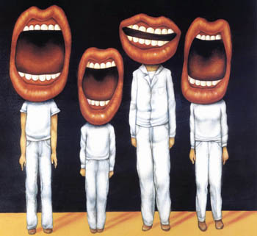
provocative (but true) statements about literacy ….
20
… while you wait
Download @ www.geoffbarton.co.uk

Slide 5
provocative (but true) statements about literacy ….
20
3: “Spoken language forms a constraint, a ceiling not only on the ability to comprehend but also on the ability to write, beyond which literacy cannot progress”
Myhill & Fisher
… while you wait
Download @ www.geoffbarton.co.uk

Slide 6
provocative (but true) statements about literacy ….
20
4: Skilful teachers explicitly teach the key vocabulary of their subject. Repetition and explanation of a word 4 times in a lesson seems to do the trick
… while you wait
Download @ www.geoffbarton.co.uk

Slide 7
provocative (but true) statements about literacy ….
20
5: When we teach writing, we should teach composition – how to generate ideas – as well as planning
… while you wait
Download @ www.geoffbarton.co.uk

Slide 8
provocative (but true) statements about literacy ….
20
… while you wait
Download @ www.geoffbarton.co.uk

Slide 9
provocative (but true) statements about literacy ….
20
6: Teachers have a responsibility to teach students how to research on the internet: Google & Wikipedia & Yahoo need informed, not innocent, users
… while you wait
Download @ www.geoffbarton.co.uk

Slide 10
provocative (but true) statements about literacy ….
20
7: Oral rehearsal works. Saying your ideas to a partner before writing them down hugely benefits students in their writing, especially boys
… while you wait
Download @ www.geoffbarton.co.uk

Slide 11
provocative (but true) statements about literacy ….
20
… while you wait
Download @ www.geoffbarton.co.uk

Slide 12
provocative (but true) statements about literacy ….
20
8: In secondary schools we don’t teach reading explicitly enough: we assume it’s been done in primary school. Get reading back on the agenda
… while you wait
Download @ www.geoffbarton.co.uk

Slide 13
provocative (but true) statements about literacy ….
20
9: It may be time to stop talking about whole-school “literacy” and just talk about teaching & learning. Good teachers teach their students to read and write better
… while you wait
Download @ www.geoffbarton.co.uk

Slide 14
provocative (but true) statements about literacy ….
20
10: Great English teachers are always reading and, more importantly, talking about their reading, reading bits aloud, asking students what they are reading
… while you wait
Download @ www.geoffbarton.co.uk

Slide 15
provocative (but true) statements about literacy ….
20
11: The most important bit of grammar our students need is sentence variety. They probably don’t need to know much else
… while you wait
Download @ www.geoffbarton.co.uk

Slide 16
provocative (but true) statements about literacy ….
20
12: C/D borderline students will join sentences with “and” too much. They need to learn to use other connectives, and to use some short sentences
… while you wait
Download @ www.geoffbarton.co.uk

Slide 17
provocative (but true) statements about literacy ….
20
13: Other connectives include:
as, when, although, while, so, therefore, however, because, despite ….
… while you wait
Download @ www.geoffbarton.co.uk

Slide 18
provocative (but true) statements about literacy ….
20
… while you wait
Download @ www.geoffbarton.co.uk

Slide 19
provocative (but true) statements about literacy ….
20
14: The most important thing we can do as teachers is to model writing: students need to see writing as a process, not a product
… while you wait
Download @ www.geoffbarton.co.uk

Slide 20
provocative (but true) statements about literacy ….
20
15: There is such a thing as “death by writing frame”
… while you wait
Download @ www.geoffbarton.co.uk

Slide 21
provocative (but true) statements about literacy ….
20
16: Improving the quality of talk in all our classrooms would have a transformational effect on results
… while you wait
Download @ www.geoffbarton.co.uk

Slide 22
provocative (but true) statements about literacy ….
20
… while you wait
Download @ www.geoffbarton.co.uk

Slide 23
provocative (but true) statements about literacy ….
20
17: Creative writing doesn’t just mean stories or poems. Emails, leaflets, text messages, travel writing, journalism – all can be creative. Students need to encounter more variety of texts
… while you wait
Download @ www.geoffbarton.co.uk

Slide 24
provocative (but true) statements about literacy ….
20
18: Tutor time could be a perfect time for building literacy – eg vocabulary games, quizzes, reinforcing key words, and so on
… while you wait
Download @ www.geoffbarton.co.uk

Slide 25
provocative (but true) statements about literacy ….
20
19: A literacy-friendly classroom will have key words (including connectives) visible plus guidance on how to write. Students taught in a room like this have an advantage over the class next door
… while you wait
Download @ www.geoffbarton.co.uk

Slide 26
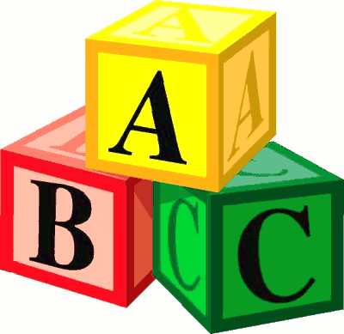
provocative (but true) statements about literacy ….
20
… while you wait
Download @ www.geoffbarton.co.uk

Slide 27
provocative (but true) statements about literacy ….
20
20: Great literacy isn’t a grand strategy: it’s teachers doing small things consistently and well. It takes great school leadership at all levels to make this happen
… while you wait
Download @ www.geoffbarton.co.uk

